Slide 1


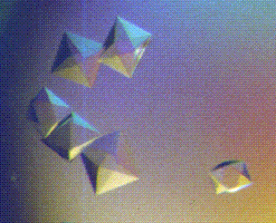


Basic concepts of protein crystallography:
The Patterson function and its use
Bernhard Rupp
University of Innsbruck
Austria
k.-k. Hofkristallamt
San Diego, CA 92084, USA
br@hofkristallamt.org, root@ruppweb.org
www.ruppweb.org

Slide 2
Teaching Motto:
Once they scroll, you’ve lost control.
ChatGPT4o, after analysis of the original paper (before review sanitized out any trace of humor)
DOI: 10.1107/S1600576725006569

Slide 3
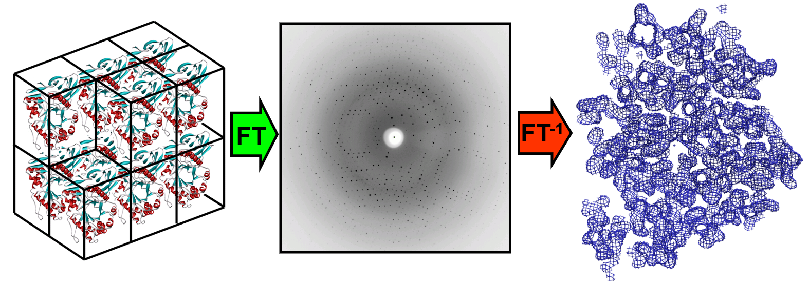
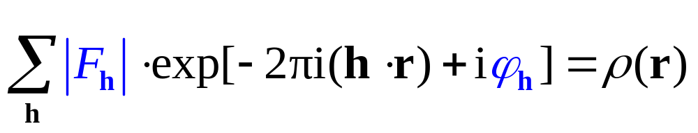
We need phases to complete the FT
✓
?

Slide 4
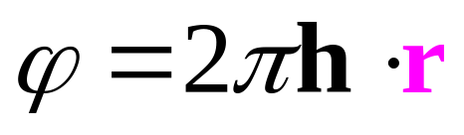
We have a (phase) problem:
We obtain only intensities proportional to |F_{h}|² from diffraction data but no phases φ_{h}. How then, do we get from intensities to phase ?
As atomic positions r determine the phase of each reflection h …
!
...obtaining (at least some) atomic positions (heavy atoms or anomalous scatters come to mind) should be useful for phase determination.

Slide 5
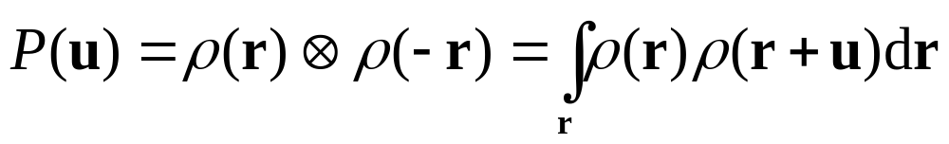

The Patterson Function P(u)
The Patterson function is the autocorrelation of electron density and informs us about interatomic distance vectors. This could be useful.
OK, let’s make this easier

Slide 6
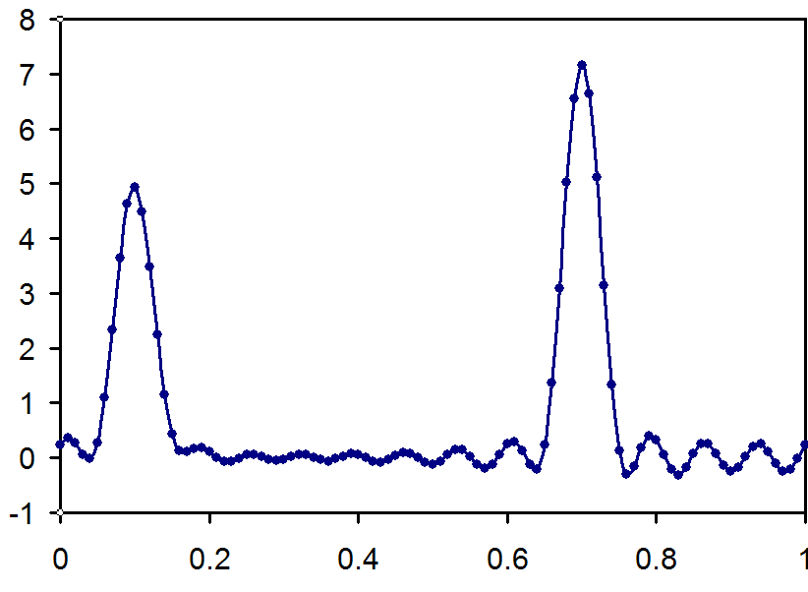
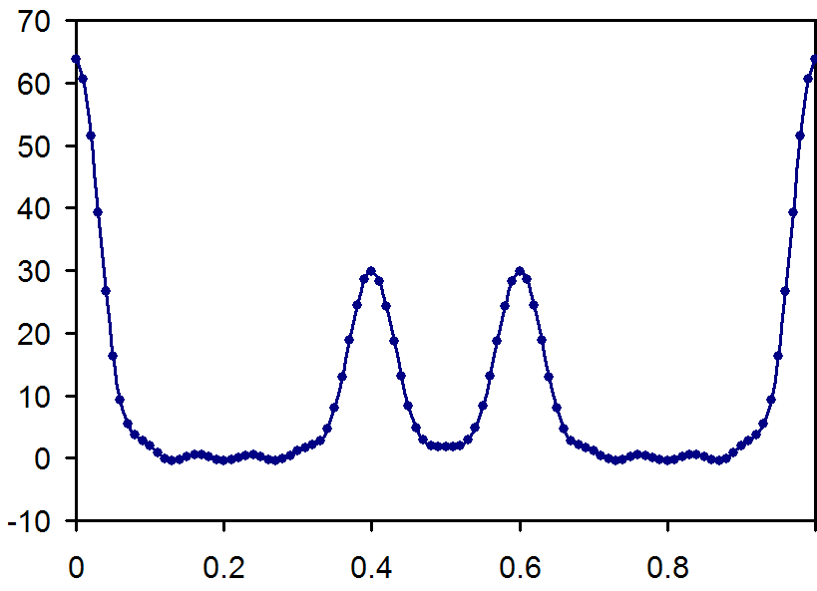
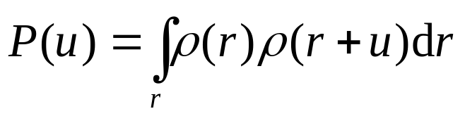
Generating the 1-d Patterson Function P(u)
C
O
ρ(r):
1d- electron density
C at r = 0.1, O at r = 0.7
ρ(r)
electron density [e⁻/Å³]
r [Å]
1
P(u)
?
Patterson function:
P(u): Autocorrelation
of ρ(r)
P(u) [e⁻/Å³]²
u [Å]
1

Slide 7
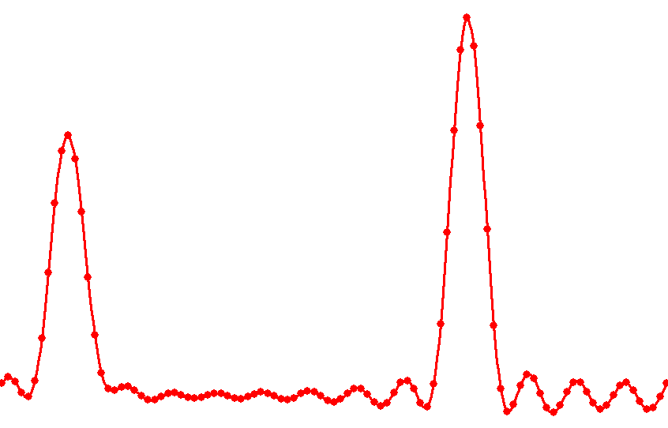

P(u): autocorrelation of electron density
u = 0
C
O
ρ(r)
Start:
Overlap density with same density
displaced by u = 0
electron density [e⁻/Å³]
r [Å]
P(u), u = 0.0
Approximation by multiplying peak height
~ 5x5 + 7x7=74
close enough…
P(u) [e⁻/Å³]²
u [Å]
1

Slide 8
P(u): autocorrelation of electron density
O
u = 0.2
C
ρ(r)
electron density [e⁻/Å³]
x [Å]
P(u), u = 0.0
P(u), u = 0.2
No significant overlaps
P(u) [e⁻/Å³]²
u [Å]
1

Slide 9
P(u): autocorrelation of electron density
O
u=0.4
C
ρ(r)
electron density [e⁻/Å³]
x [Å]
0
P(u), u = 0.2
P(u), u = 0.4
P(u) [e⁻/Å³]²
Overlap here
~ 5 x 7 = 35
u [Å]
1

Slide 10

P(u): autocorrelation of electron density
O
u =0.6
C
ρ(r)
electron density [e⁻/Å³]
x [Å]
0
P(u), u = 0.4
P(u), u = 0.6
Overlap here
~ 7 x 5 =35
P(u) [e⁻/Å³]²
u [Å]
1

Slide 11
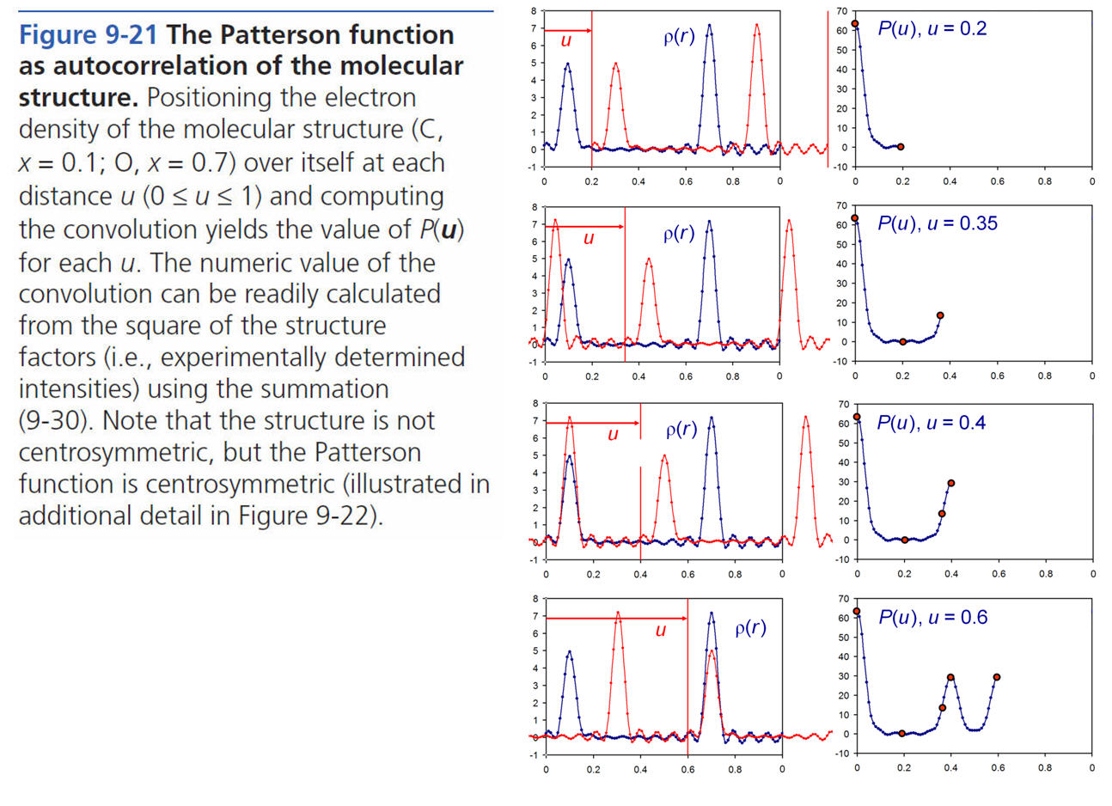
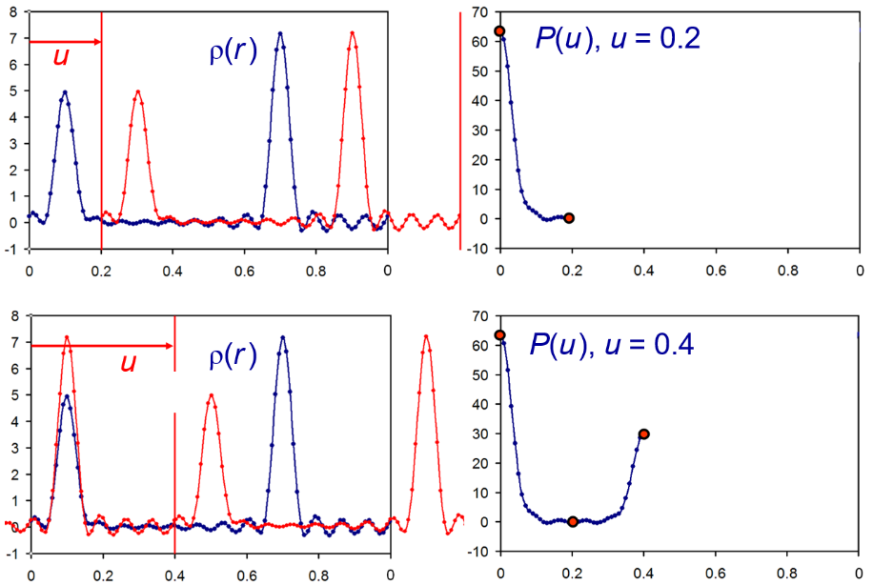
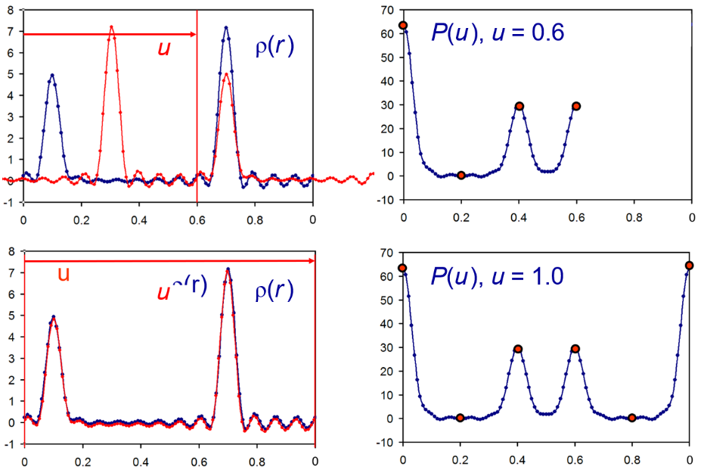
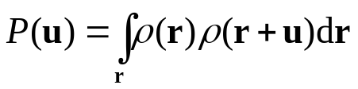
P(u): autocorrelation of electron density
At u = 0 full overlap

Slide 12
What does the Patterson function tell us?
ρ(r)
electron density [e⁻/Å³]
r [Å]
0
r [Å]
Interatomic distance
Vectors!
P(u)
P(u) [e⁻/Å³]²
u [Å]
0
u [Å]
1

Slide 13
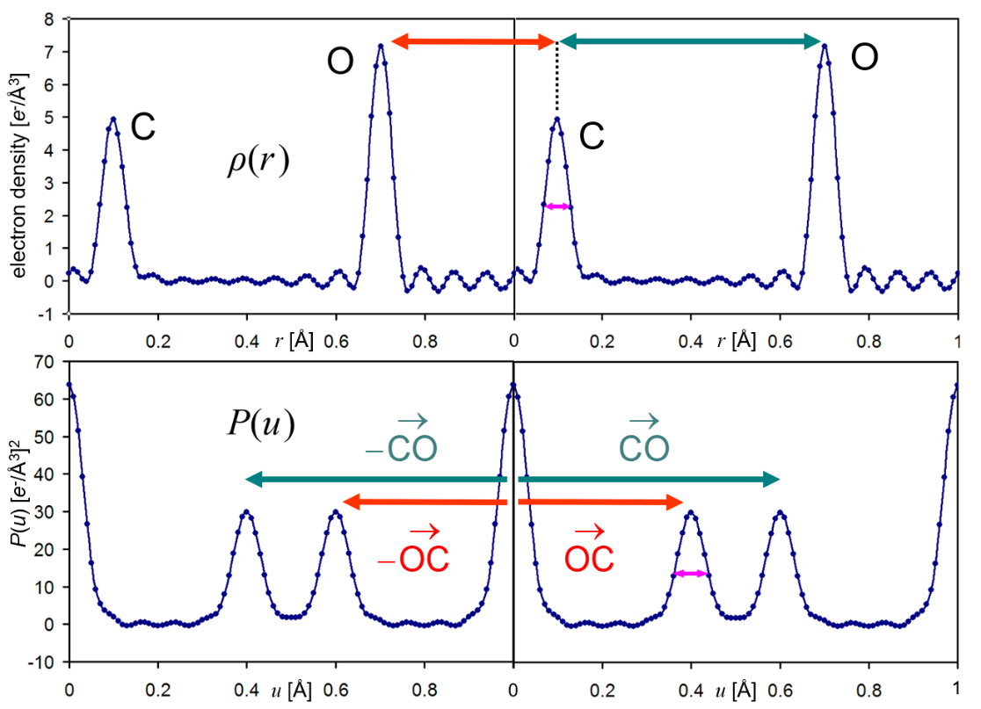
What does the Patterson function represent?
The Patterson map is an interatomic distance vector map. As a result of the convolution, its N² peaks are twice as broad as the electron density peaks. This means it will be useful in situations with a limited number of atoms, such as heavy or anomalous atom substructure determination.
In contrast to electron density, the Patterson map is always centrosymmetric, which means the handedness of any substructures derived from it will be ambiguous.

Slide 14
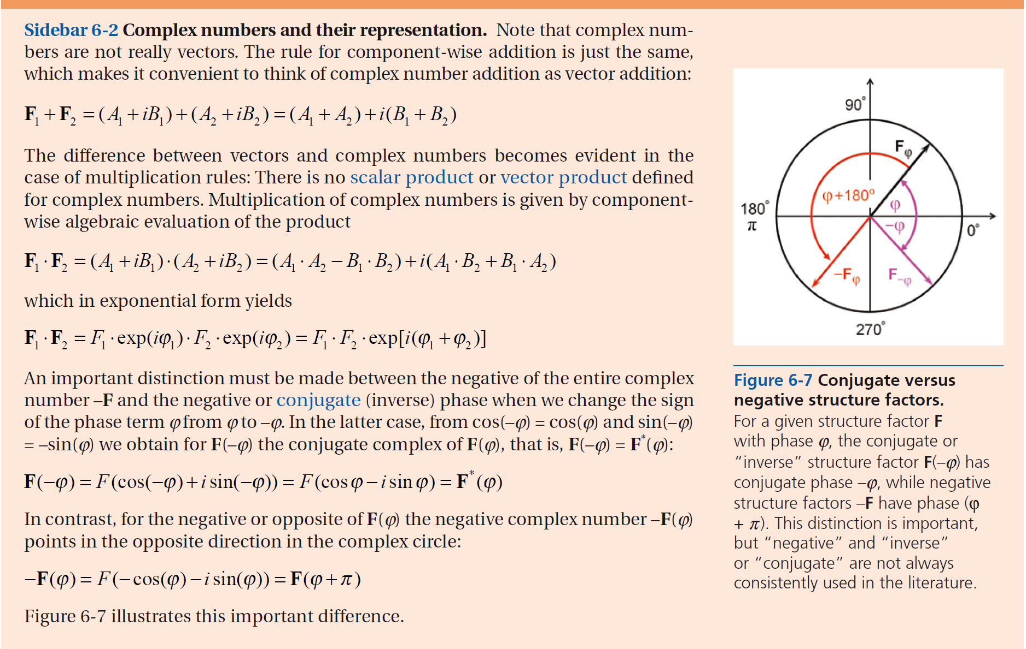
Optional slide: basic complex algebra of F_{h}

Slide 15


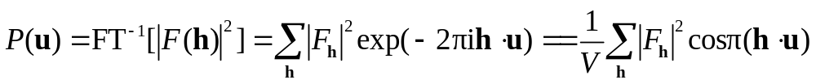
The remaining big question: how can we calculate P(u) from intensities, which is all we have so far?
The electron density is the FT of the set of complex structure factors
We apply the Fourier convolution theorem to the Patterson convolution
The product of complex F with its conjugate F* is |F|² : amplitude²
|F_{h}|² known from measured intensities I_{h}!
Fourier back-transform, use centrosymmetry, Euler, gives real function P(u)

Slide 16
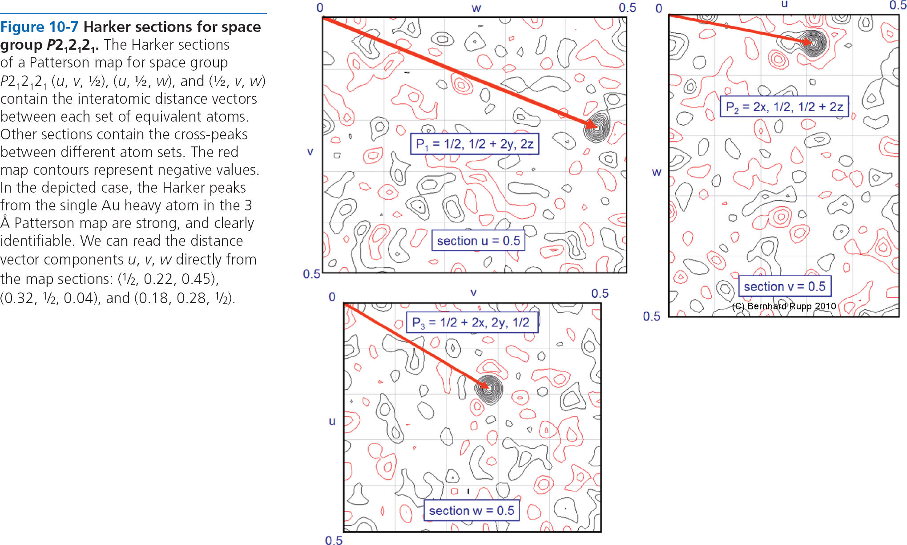
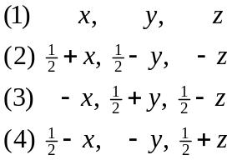
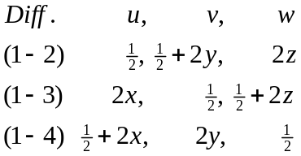
Position determination from special Patterson peaks
---------------- u ----- v ----- w ------ height --
ATOM1 Ano 0.0000 0.0000 0.0000 138.46
ATOM2 Ano 0.3150 0.5000 0.0472 12.76
ATOM3 Ano 0.1878 0.2826 0.5000 11.84
ATOM4 Ano 0.5000 0.2167 0.4518 10.24
ATOM5 Ano 0.0837 0.5000 0.0000 4.46
ATOM6 Ano 0.0000 0.5000 0.0509 3.63
ATOM7 Ano 0.3761 0.5000 0.0000 3.48
... etc
The Patterson maps generally get solved by superposition methods.
Patterson methods are
also used as seeding techniques for direct methods phasing.
u, v, w are known from peaks

Slide 17
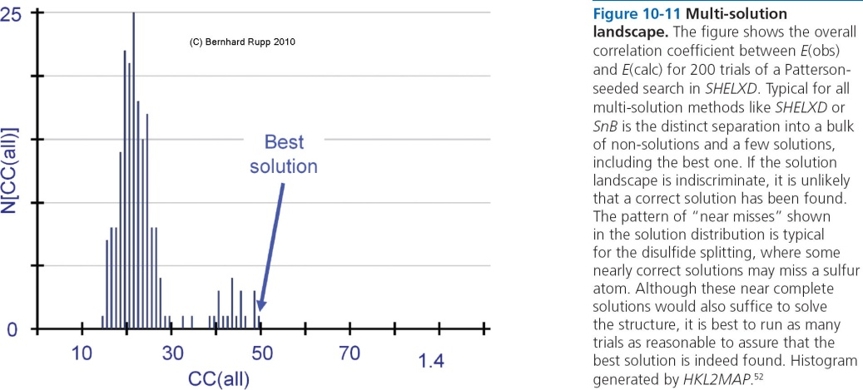
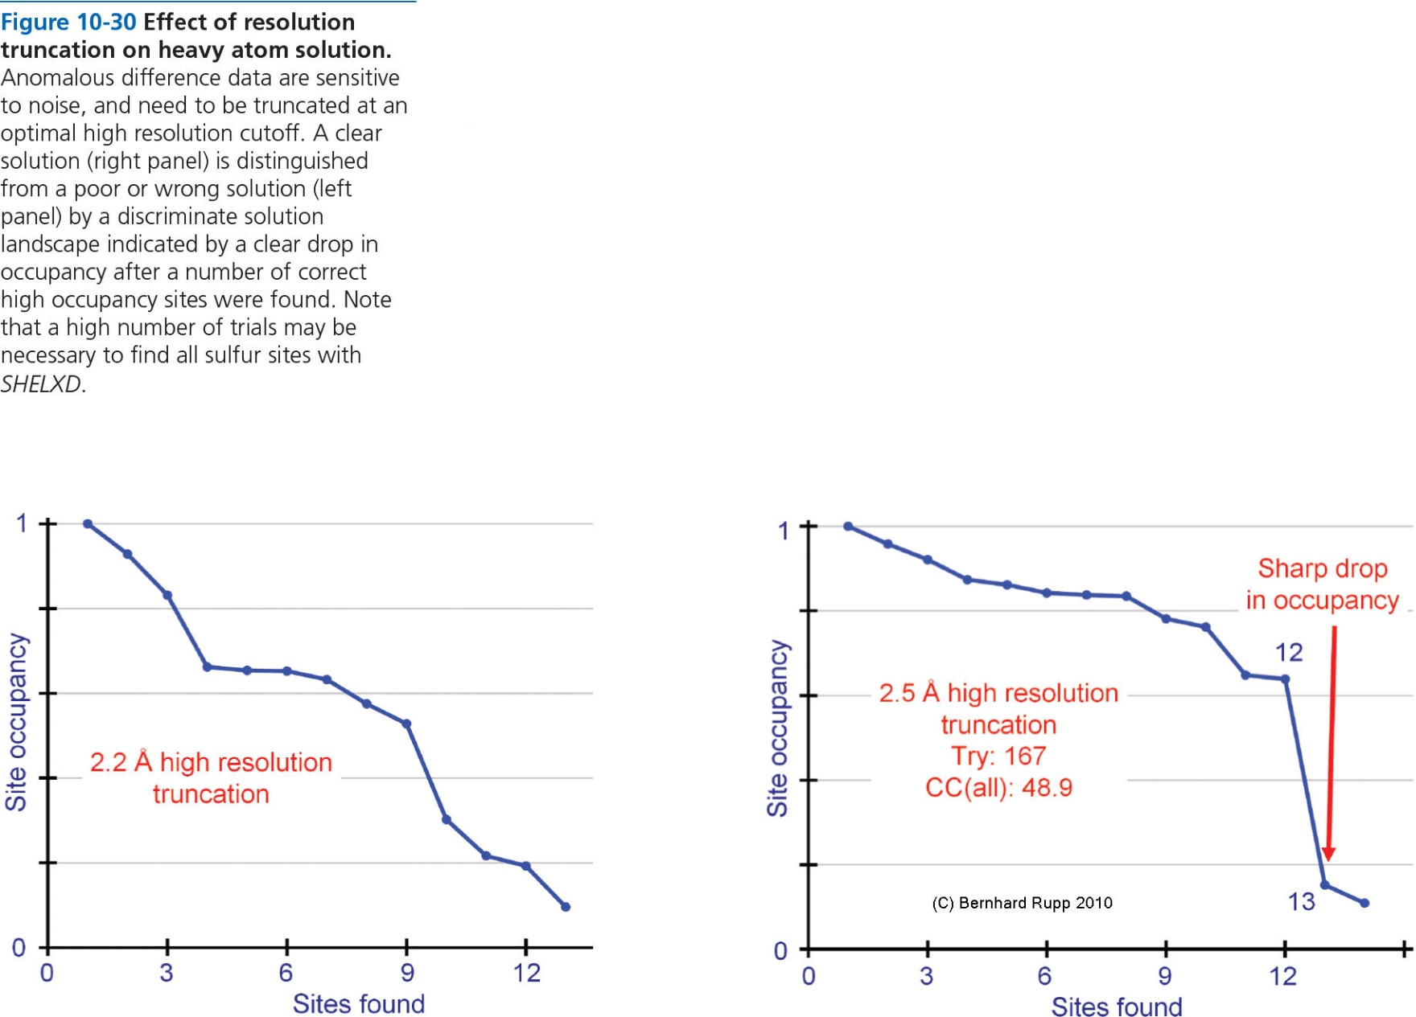
Multisolution landscape with SHELXD
Sharp drop in occupancy after expected number of correct atoms is a sign of correct solution.

Slide 18
Summary of insights (Test!)
The Patterson function, defined as the autocorrelation of the electron density, can be computed from the experimentally accessible squared structure factor amplitudes, that is, the Patterson function is intensity-based. The peaks in the Patterson function are interatomic distance vectors, from which the atomic positions of the atoms giving rise to the electron density can be computed. As position determines phase, the Patterson function is the basis for position-based macromolecular phasing techniques.
Patterson seeding combined with direct methods is used to determine the position of up to a few hundred heavy or anomalous marker atom substructures of biomolecular structures. As position determines phase, knowledge of substructure atom positions is the basis of experimental substructure phasing techniques.
The Patterson function is centrosymmetric, which implies a loss of handedness information, giving rise to the handedness ambiguity in substructure solutions.
The Patterson function can be used as a general correlation function to determine the orientation and position of structurally similar molecules in unknown crystal structures, which is used in Molecular Replacement phasing.
A special form is the Patterson self-rotation function, which allows to determine the internal rotational symmetry of a non-crystallographic symmetry assembly (motif) in a crystal structure from intensity data alone.
A native Patterson map can reveal a proper non-crystallographic symmetry axis parallel or very nearly parallel to a crystallographic axis from intensity data.

Slide 19



We are ready to phase!

